Slide 1
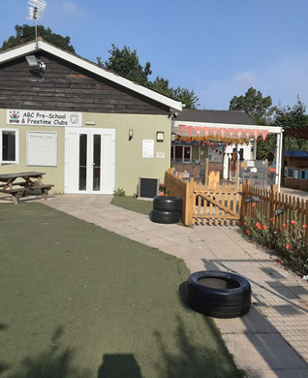
ABC Childcare Ipswich Ltd
Here at ABC, our aims are simple. We want to provide the best possible setting for your child to learn and grow. We offer a bright, safe, friendly and encouraging environment for every child. We want all of our children to enjoy their time here, challenge themselves through independent play and supported learning and explore their potential to the full.

Slide 2
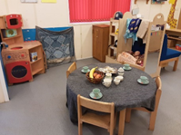
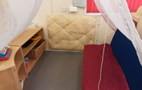
Role play and technology: an area to explore your imaginations, you can be who or whatever you want. This area is changed to reflect the children’s interests. What will you be when you come and play?

Slide 3
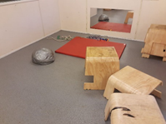
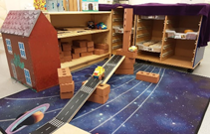
Movement Space: a place where you can do lots of big movement’s inside. Developing gross motor skills.
This area is also used for carpet time at the end of session before you go home.
Construction and small world: Practice your building skills in this area. Let your imagination run wild the possibilities are endless.

Slide 4
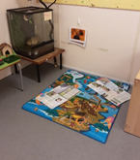
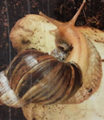
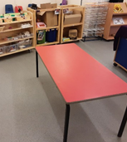
Arts and crafts, you can access all the resources here independently and let your creativity flourish. The area is also used for malleable, such as playdough.
Science and Nature: Meet Harley our pet, a giant African Land Snail, he lives in this area, you will explore loose parts, natural objects and learn to take care of our pet.

Slide 5
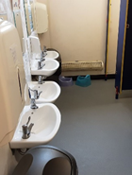
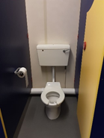
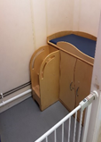
Here you have access to our toilets or potty’s, you can do this independently and you also have access to sinks to be able to wash your hands. An adult can help you if you need them.
If you are in a nappy you will be asked by an adult to change your nappy, then you will independently climb the steps and be changed on the nappy unit.
This is where you will eat snack, it is your choice if you would like some snack. You will need to wash your hands first then collect your cup and plate, sit down and you can choose from our snack menu what you would like to eat. When you’re finished you will return you cup and plate to the trolley

Slide 6
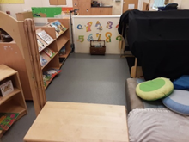
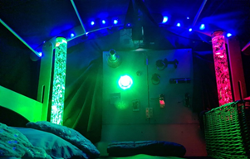
Reading Corner: A quiet area where you can jump into the world of books. Having story time independently, with a friend or with an adult.
Sensory Den: A quiet space where you can explore and develop your different senses. Accessing, fidget board, a range fidget toys and textured blankets.

Slide 7
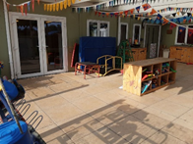
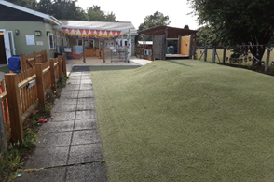
Undercover area, here we have lots of loose parts and activities for you to self-choose. Such as, balance boards, ball games and parachutes. We also have an obstacle course, an adult will help you set this up.
You can play in the garden no matter the weather

Slide 8
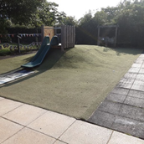
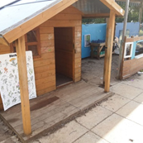
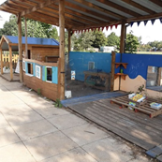
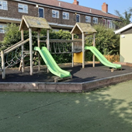
Hill, slide, musical area and road, we do a lot of big movement in this area as well as using bikes and scooters. When our sand area is closed we utilise this space for quiet activities such as reading.
We also go in small groups to the climbing frame in the other garden. Here you can develop your gross motor skills and confidence with climbing large play equipment.
Wendy house, Mud kitchen and sand pit which are great for imaginative play.

Slide 9
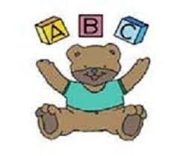
Please copy and paste the link below into your browser to view our Preschool Tour:
https://youtu.be/5vmZAVEeOck
Our website: https://abcchildcare.org.uk/
Our facebook: ABC Preschool - Ipswich Ltd
Our contact number: 01473 718296 option 3

